Slide 1
Microservices

Slide 2
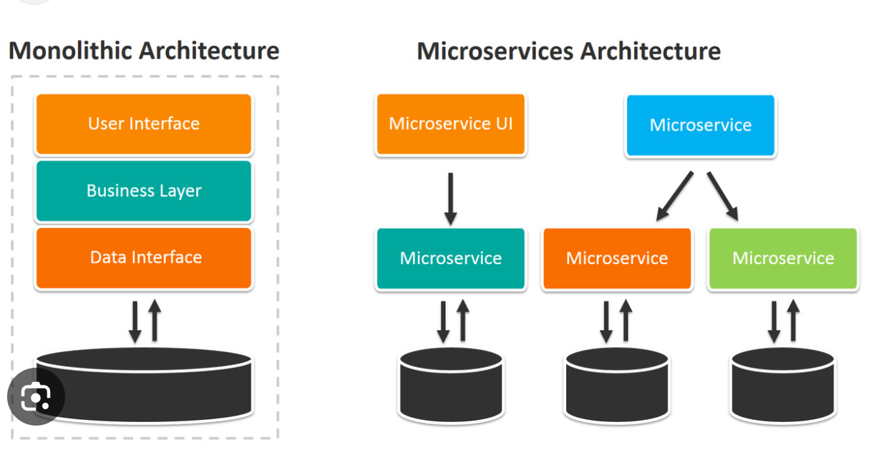

Slide 3
Monolithic
Hard to Adopt New Technologies: Migrating to new frameworks or languages is difficult.
Low Fault Isolation: A failure in one module can crash the entire application.
Tight Coupling: All components are interconnected, making it hard to isolate and modify parts independently.
Scalability Issues: You can only scale the entire application, even if only one part needs more resources.
Limited Technology Flexibility: You’re often stuck with one tech stack across the whole application.

Slide 4
Hard to Maintain: As the codebase grows, it becomes more complex and harder to manage.
Onboarding Difficulty: New developers may struggle to understand the entire system before contributing.
Complex Testing: Testing the whole application is time-consuming and error-prone.
Risky Deployments: A single bug can bring down the entire system during deployment.
Poor Separation of Concerns: Teams working on different features may interfere with each other’s code.
Limited Parallel Development: Hard to work on multiple features simultaneously without conflicts.

Slide 5
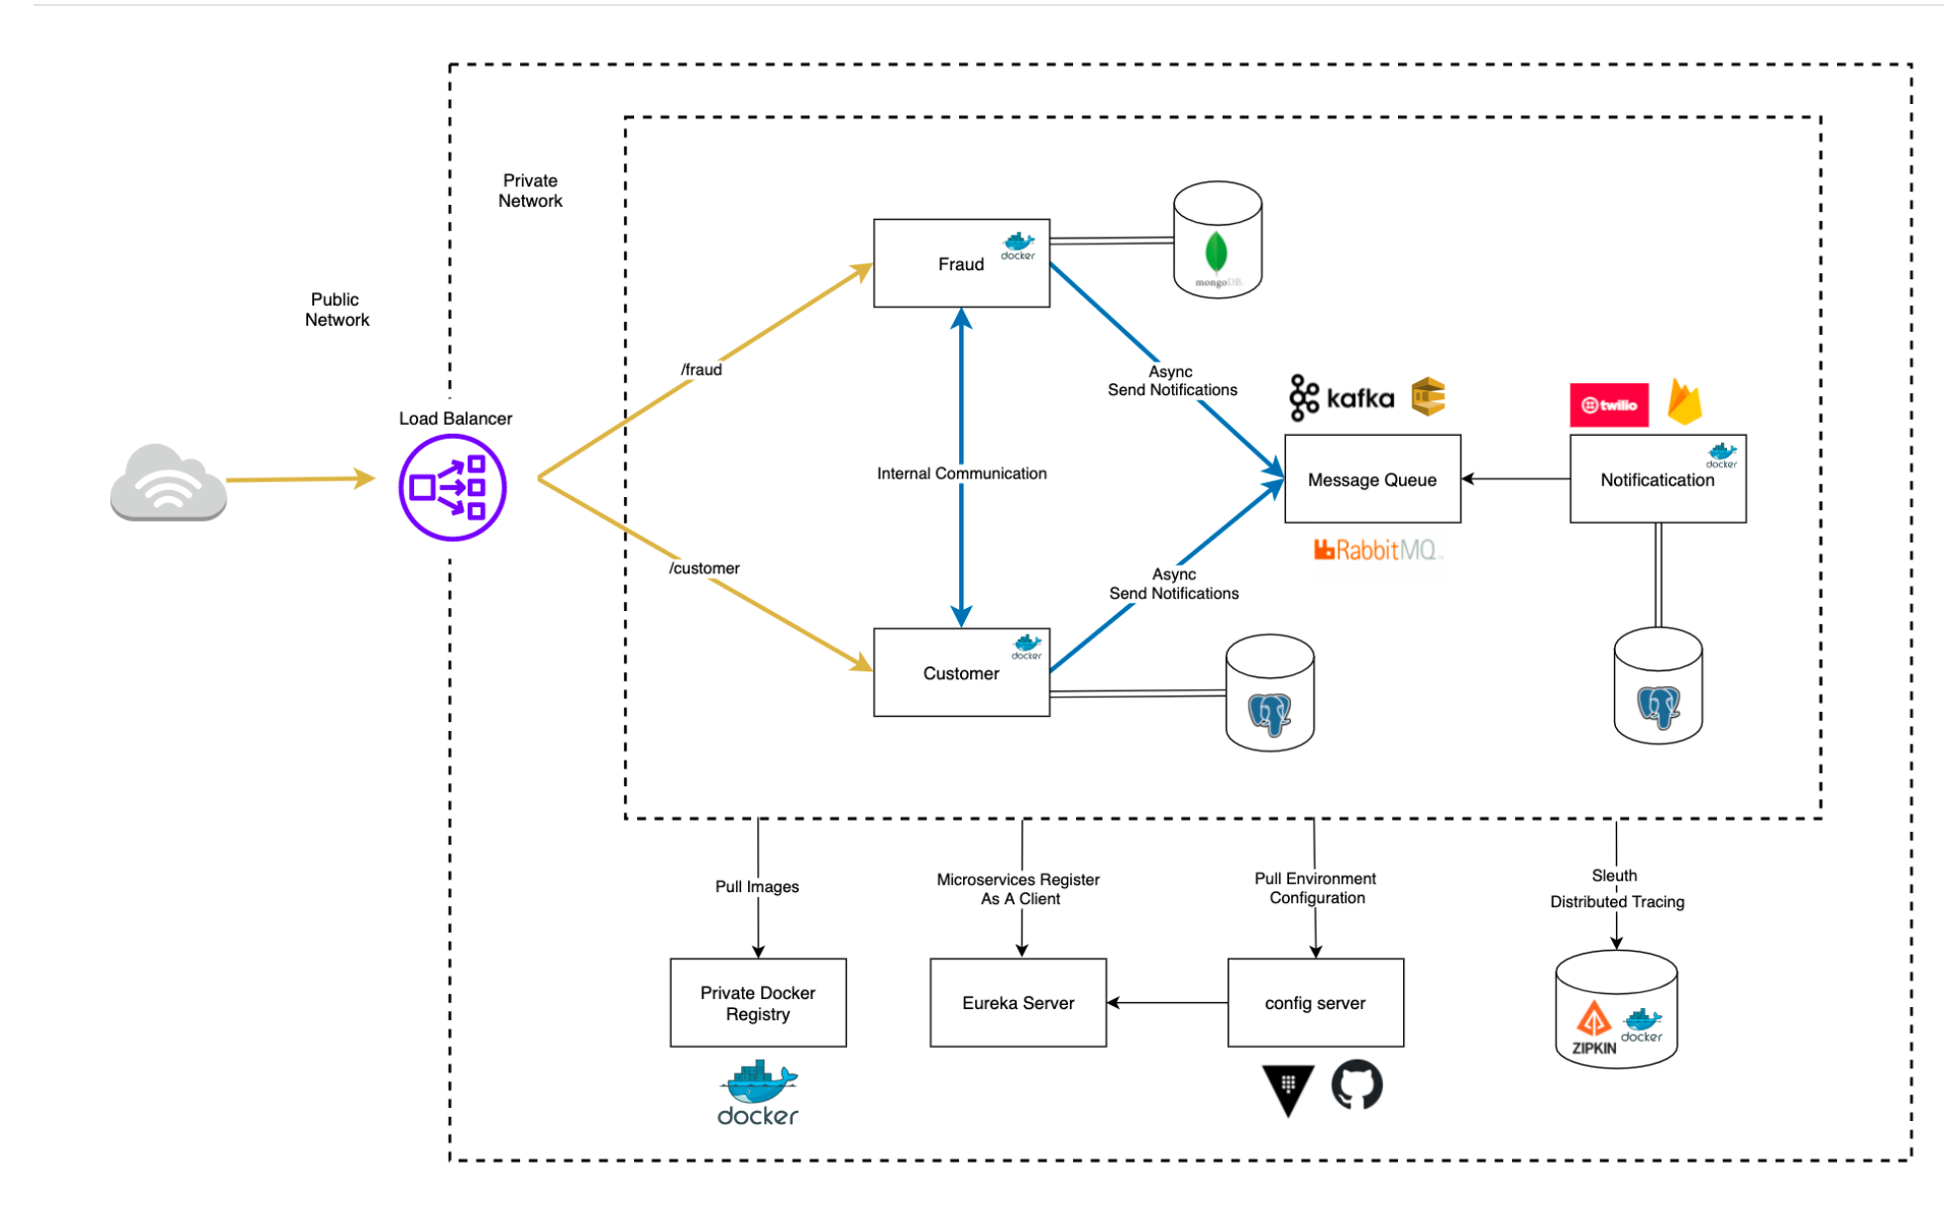

Slide 6
Core Components
Device Service: Handles registration, updates, and status of devices.
User Service: Manages users who own or interact with devices.
Telemetry Service: Collects and stores data from devices.
Notification Service: Sends alerts or updates based on device events.
Firmware Service: Manages firmware updates and versioning.

Slide 7
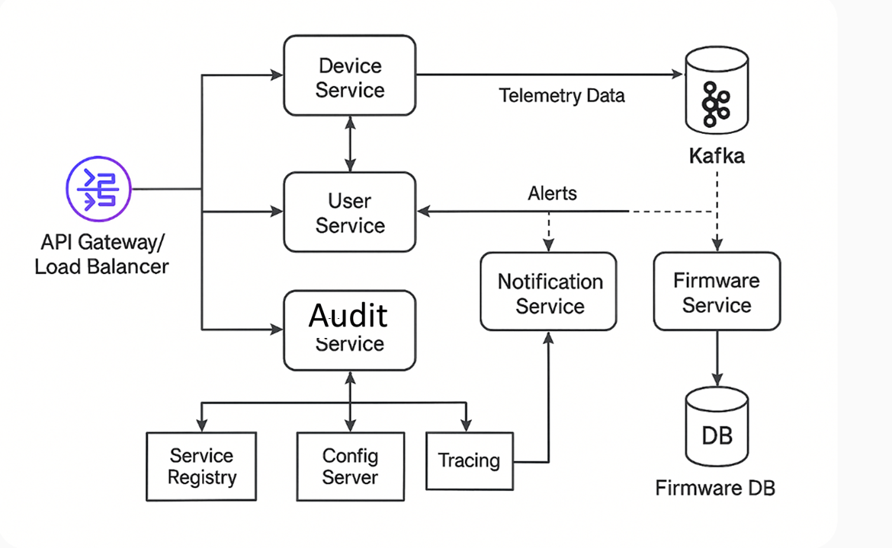
Collects and processes data sent from devices in real-time or at intervals.
Device status (online/offline, battery level), Error logs or performance metrics
Data exchanged
Error logs or performance metrics
User login/logout
Device configuration changes
Firmware updates initiated
Access to sensitive data

Slide 8
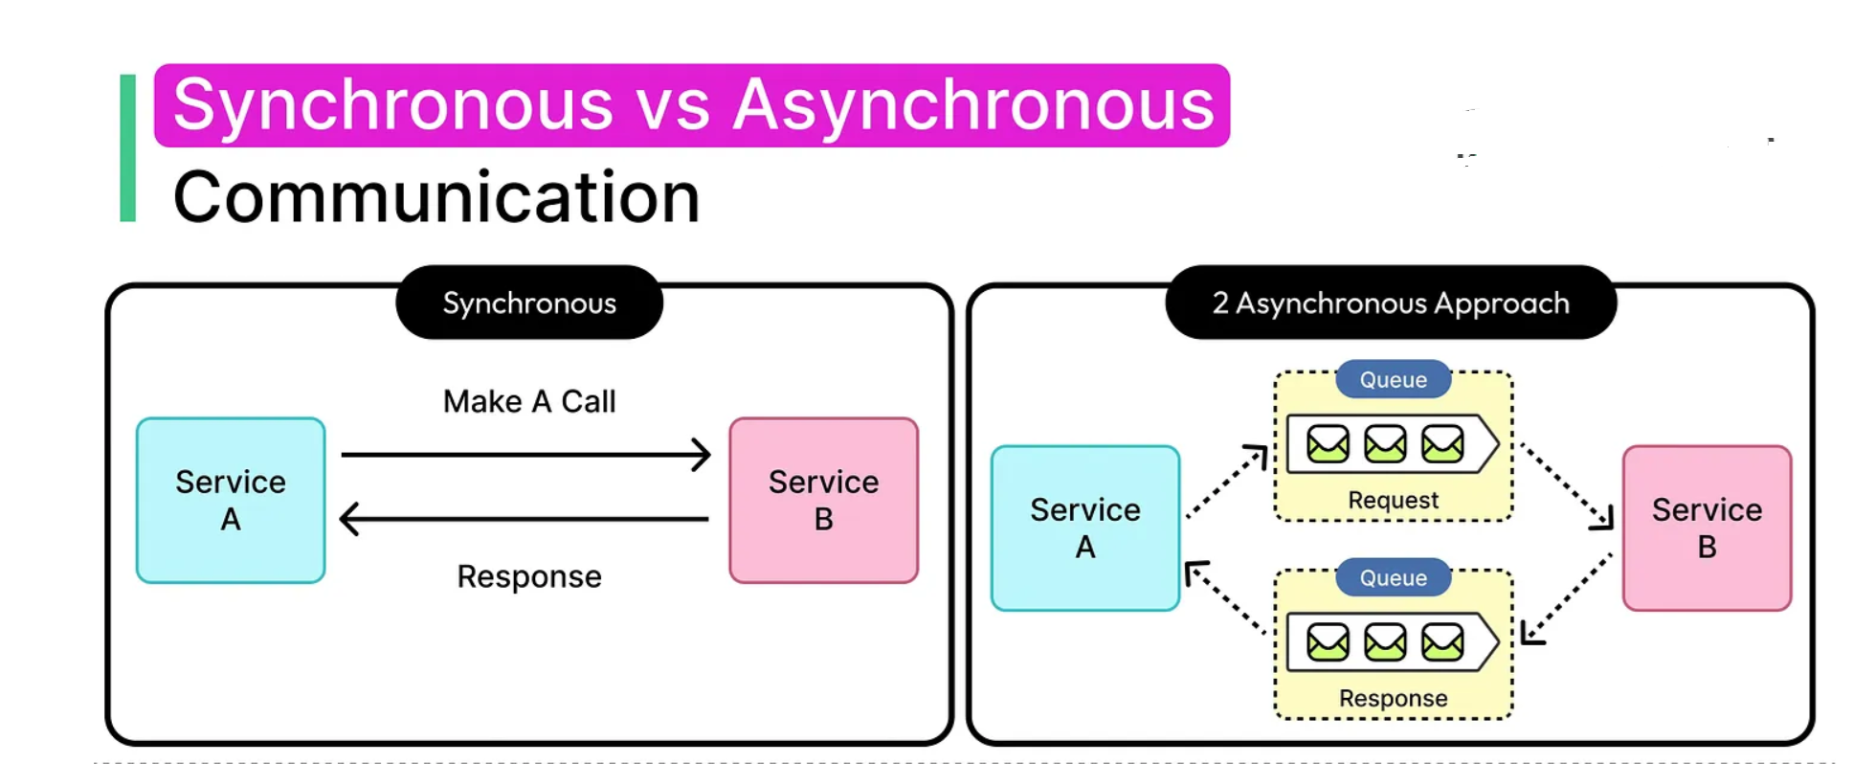

Slide 9
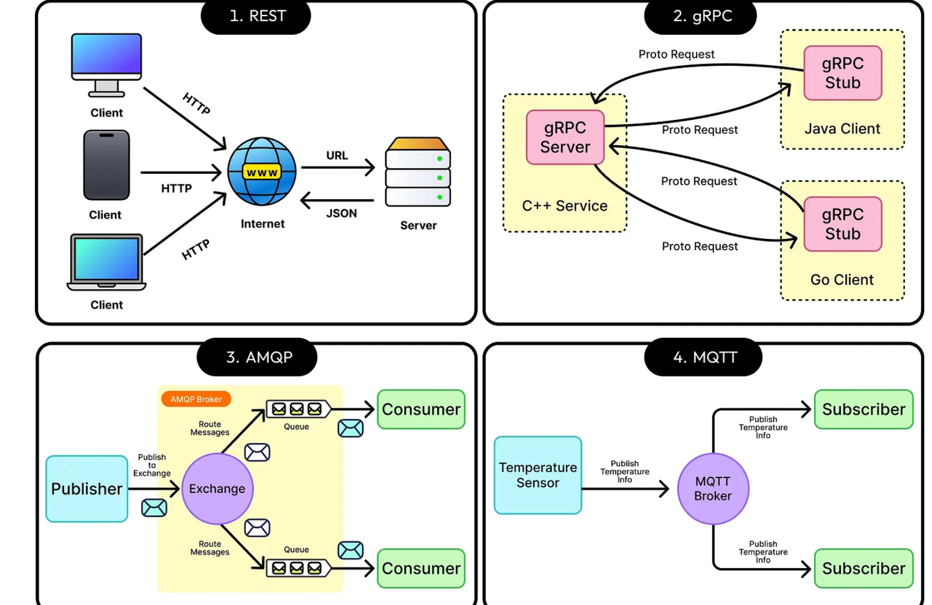

Slide 10
Infrastructure & Communication
API Gateway / Load Balancer: Entry point for external requests.
Service Registry (Eureka): For service discovery.
Config Server: Centralized configuration management.
Message Broker (Kafka/RabbitMQ): For asynchronous communication (e.g., telemetry, alerts).
Tracing (Zipkin): For monitoring service interactions.

Slide 11
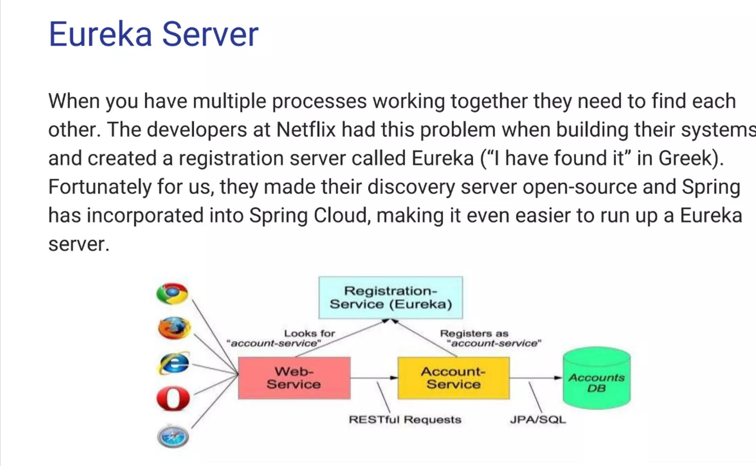

Slide 12
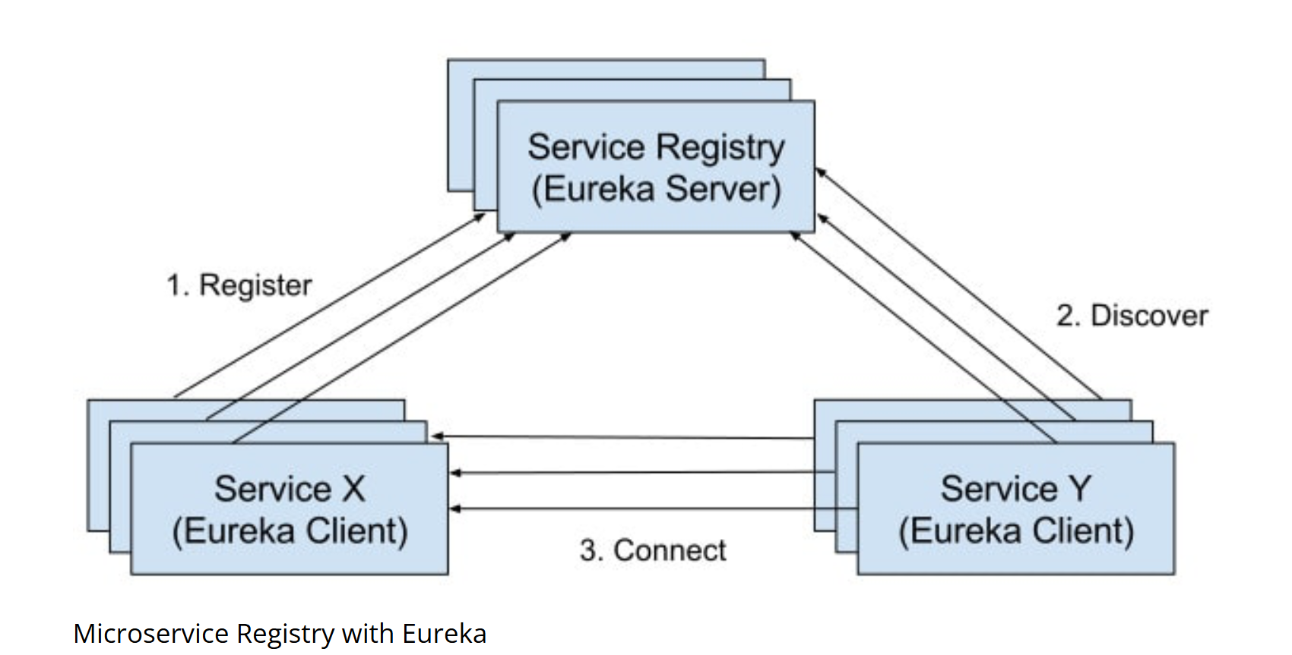

Slide 13
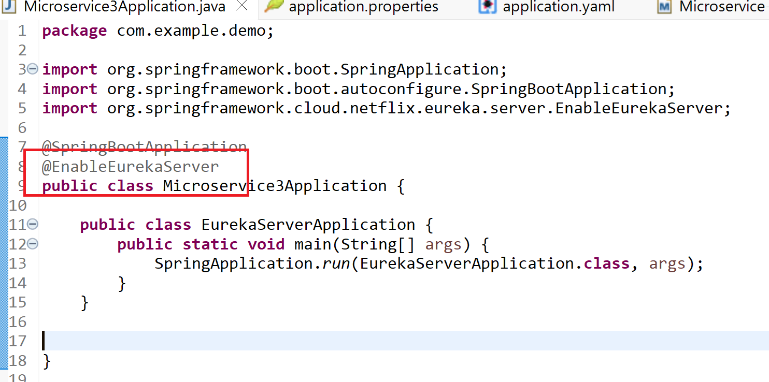

Slide 14
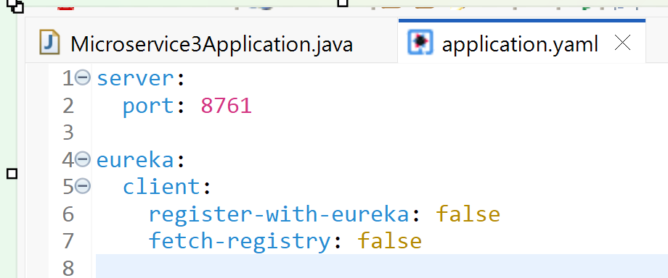
✅ register-with-eureka: false
This tells the Eureka Server not to register itself as a client.
Normally, microservices register themselves with Eureka so they can be discovered.
But the Eureka Server is the registry itself, so it doesn’t need to register.
✅ fetch-registry: false
This tells the Eureka Server not to fetch the list of services from other Eureka servers.
This is useful when you have only one Eureka Server (not a cluster).
In a cluster setup, you might set this to true so servers sync with each other.

Slide 15
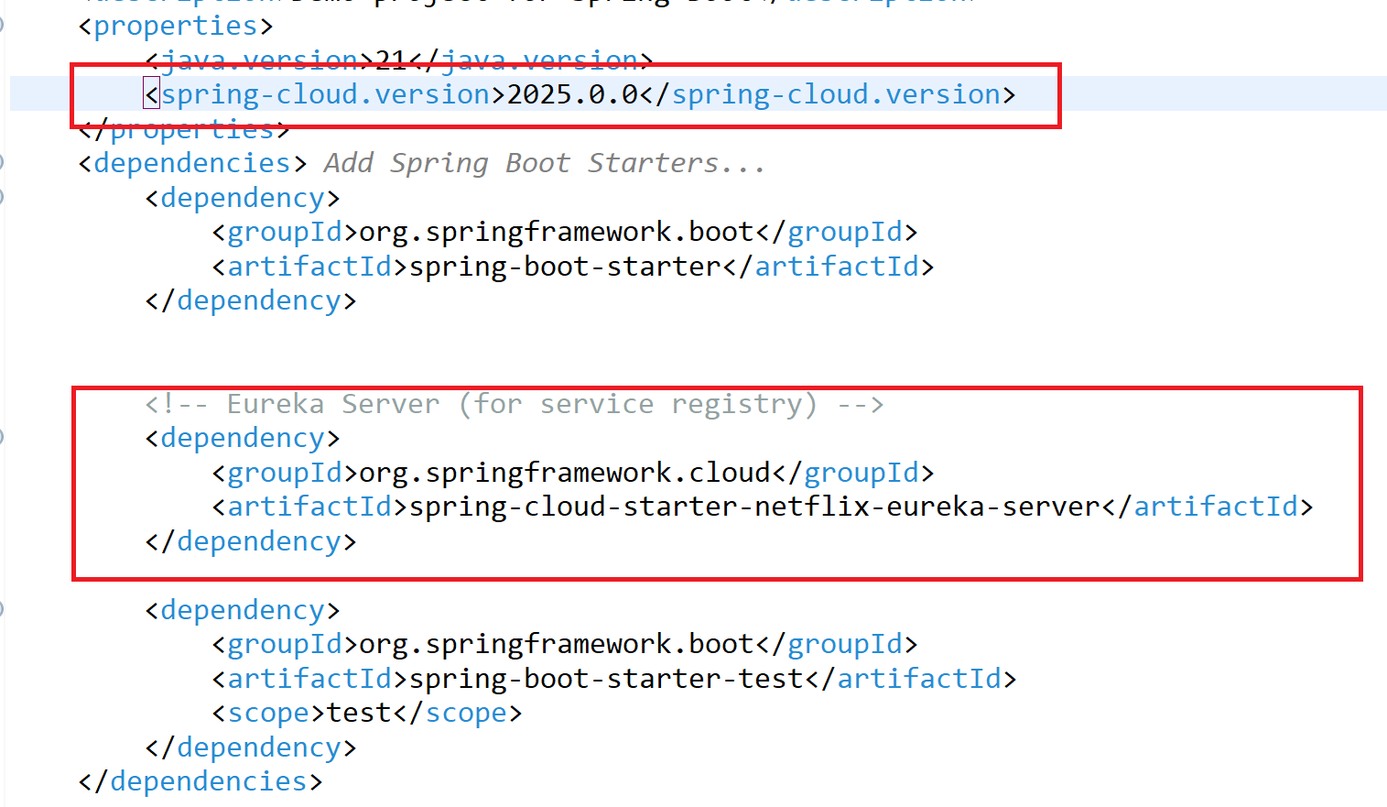
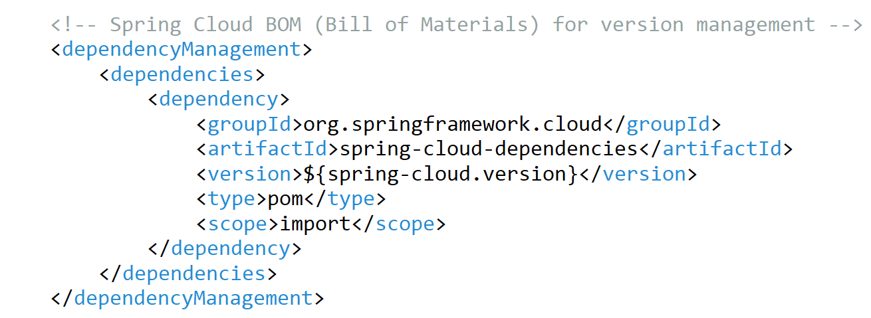

Slide 16
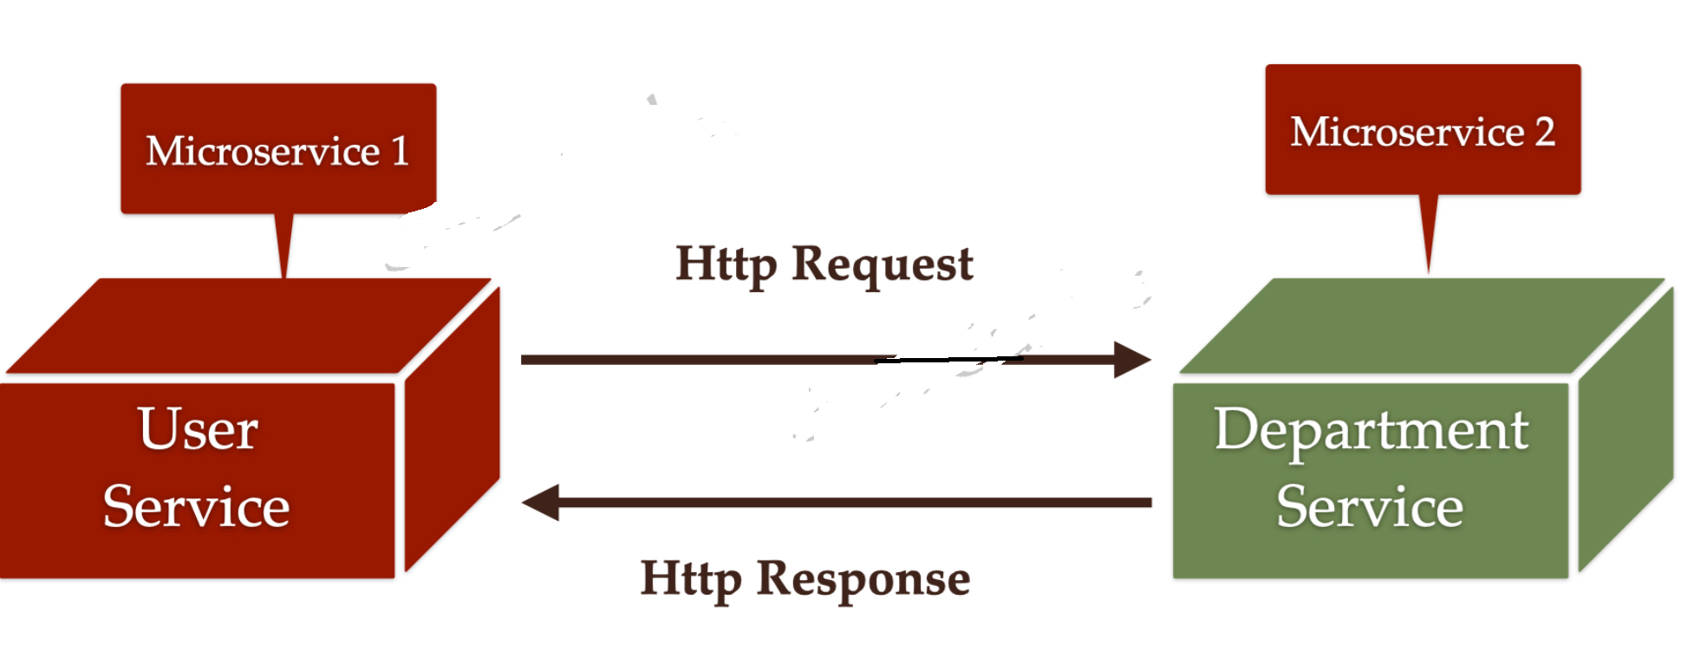
Interservice communication:
Feign Client is a declarative web service client provided by Spring Cloud. It simplifies HTTP communication between microservices by allowing you to write Java interfaces to call REST APIs, instead of manually using RestTemplate or WebClient.

Slide 17
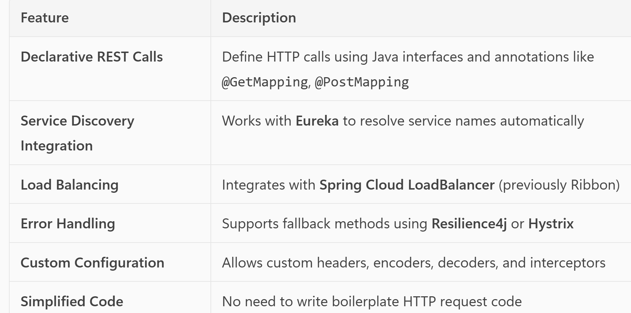

Slide 18
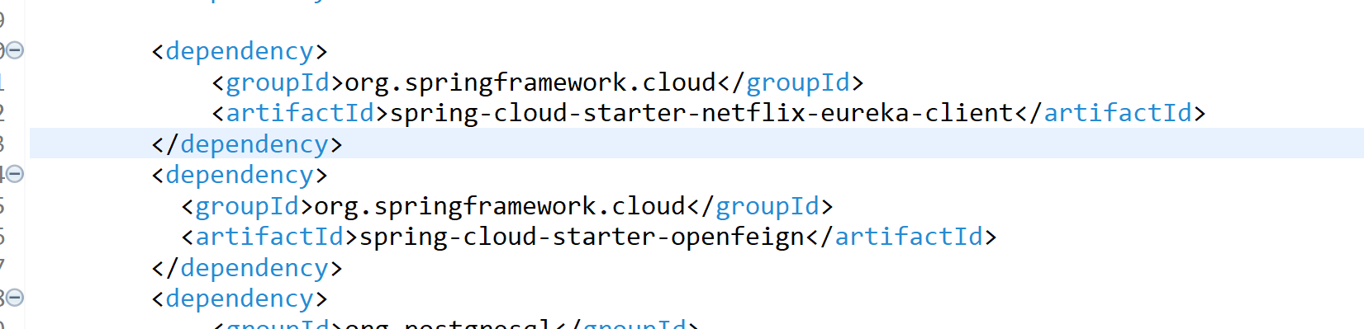
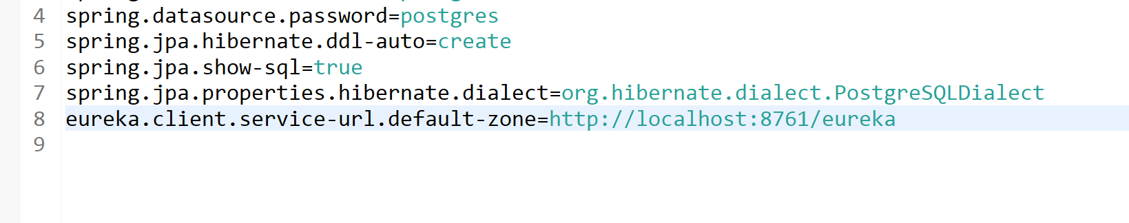

Slide 19
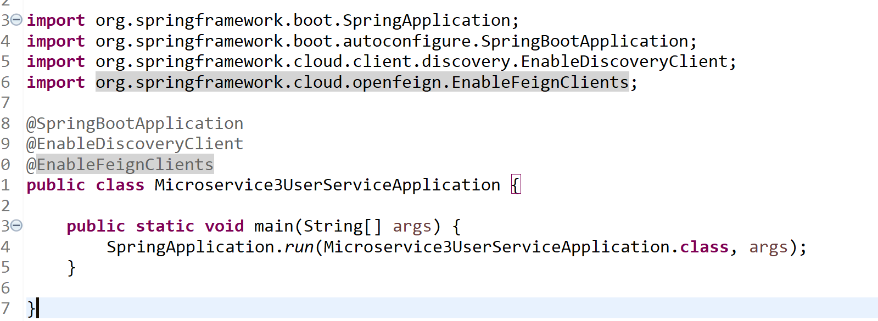

Slide 20
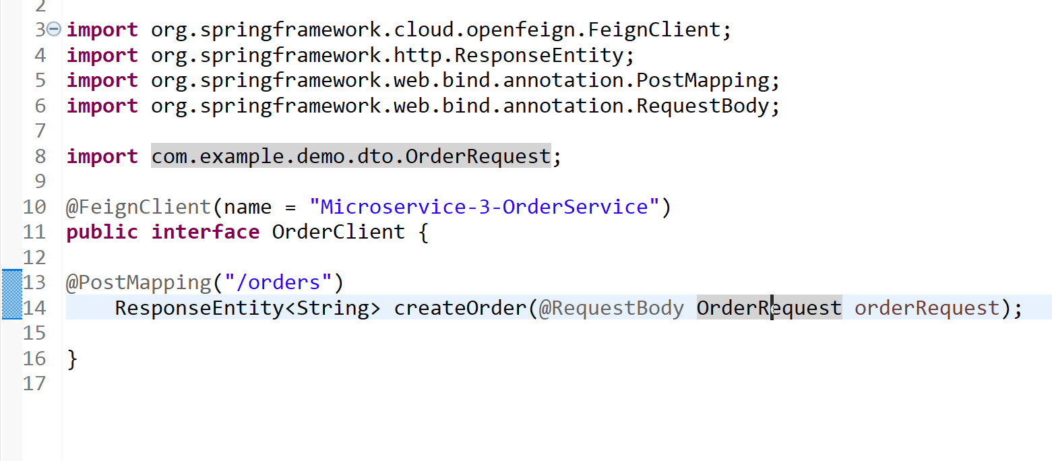

Slide 21
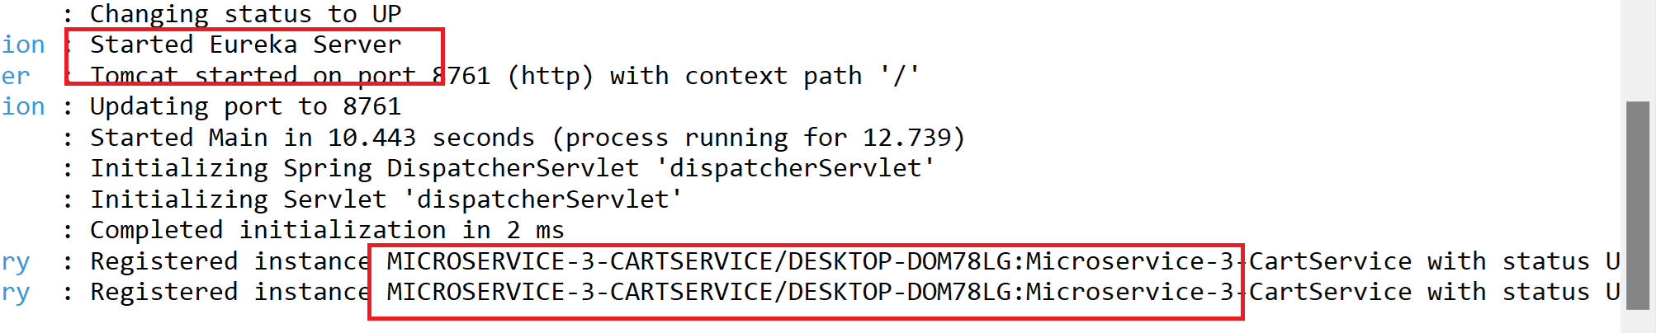

Slide 22
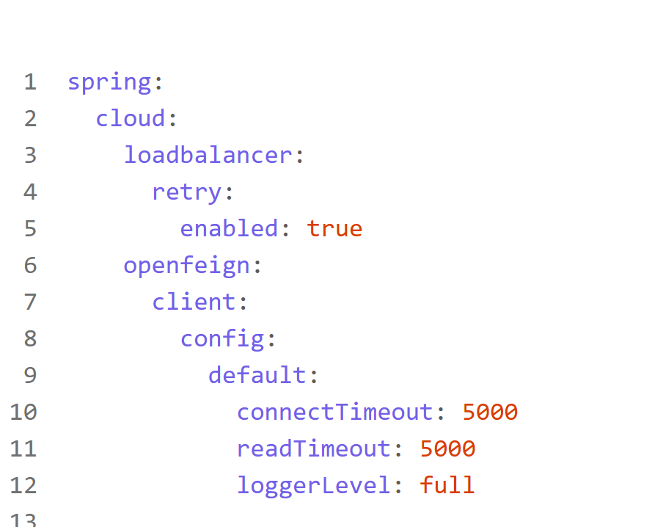
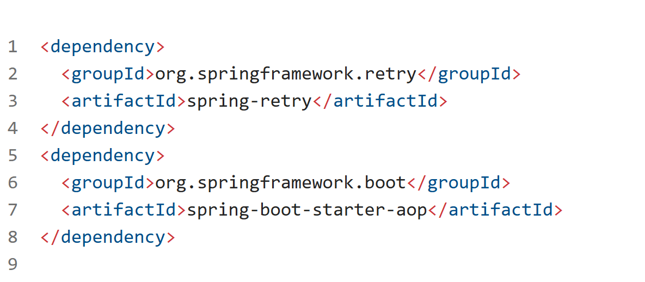
Optional:

Slide 23
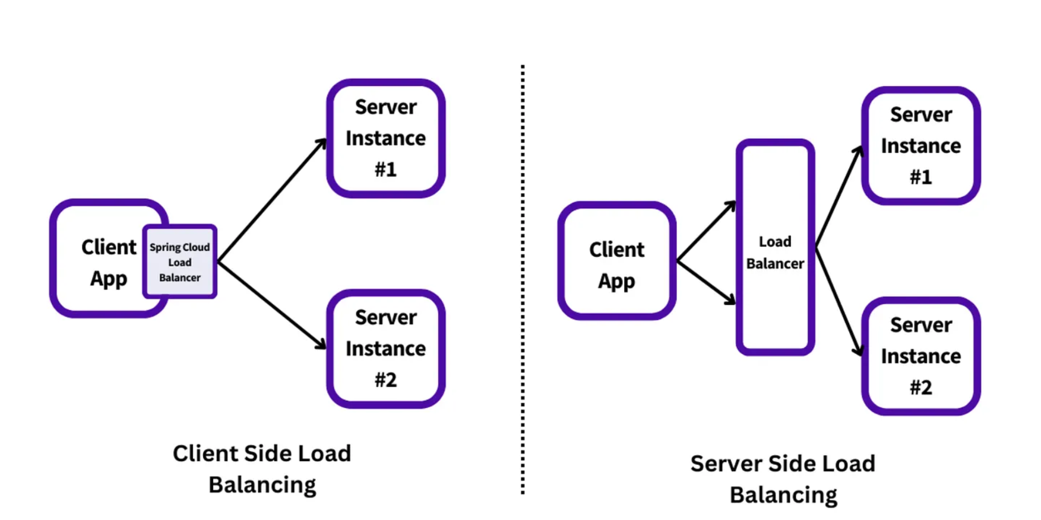
Client Side Load Balancing

Slide 24
Feign uses Spring Cloud LoadBalancer for client-side load balancing.
You call a service by its name (e.g., "order-service").
Feign + Eureka + LoadBalancer will:
Discover all instances of order-service
Choose one instance based on a load balancing strategy (e.g., round-robin)
Send the request to that instance
Client-side load balancing removes that extra hop. Each client receives a list of healthy backend servers. It stores this list locally and decides where to send requests. This makes routing faster, more reliable, and easier to scale.
Instead of one router doing all the work, each client shares the load.

Slide 25
Advantages of Client-Side Load Balancing
Reduced Latency
Requests go directly from client to server. There’s no central router to slow things down.
2. No Single Point of Failure
If one client fails, others keep working. There’s no central piece to bring the system down.
3. Better Traffic Distribution
Each client spreads its own traffic. This balances the load across all servers.
4. Local Control
Clients make routing decisions based on real-time feedback. They can retry quickly or back off when needed.
5. Easy to Scale
As services grow, adding new clients or servers doesn’t overload a central router. The system scales naturally.

Slide 26
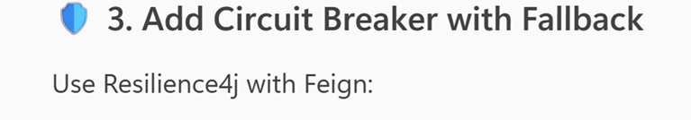
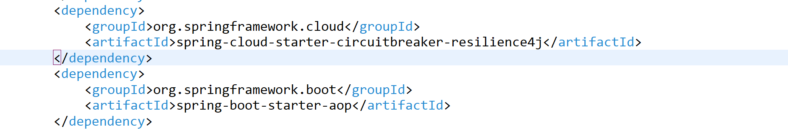
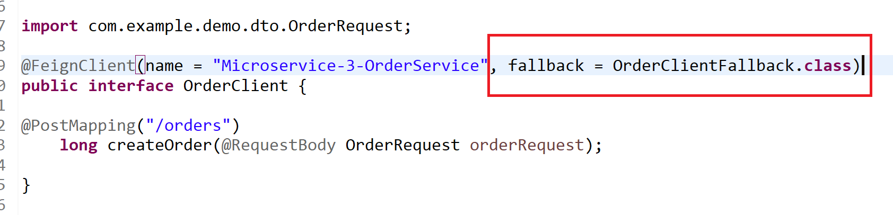
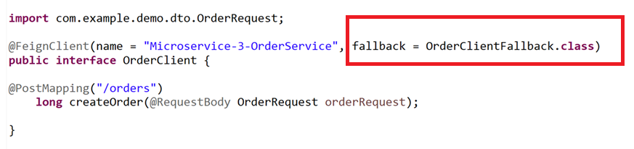

Slide 27
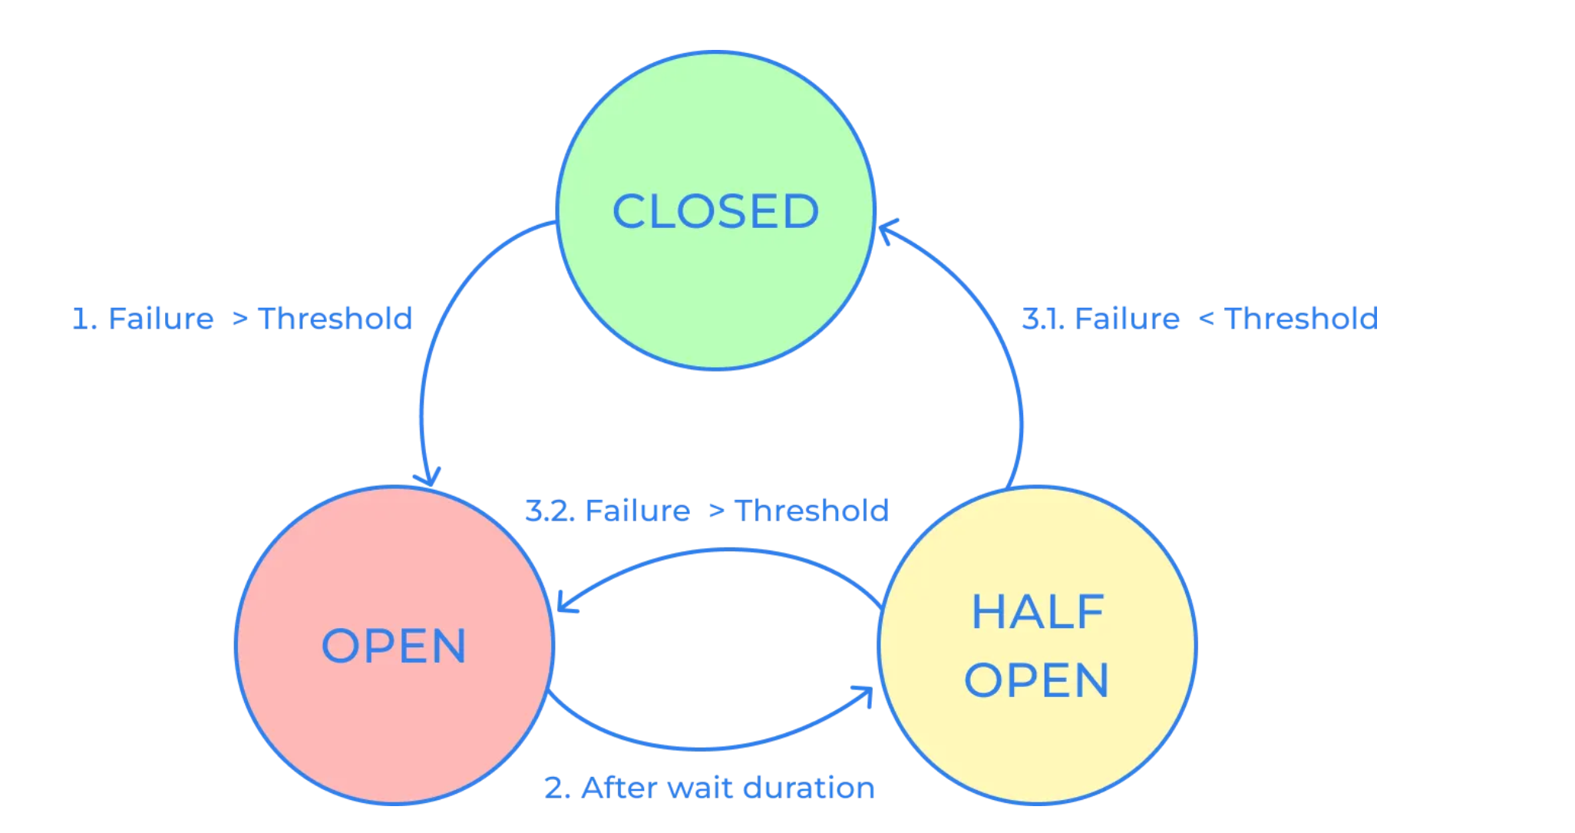
When the “circuit” is CLOSED, requests can reach the service, when it is OPEN it fails immediately. After a period of time
OPEN it moves to HALF_OPEN, if the failures are below the threshold it moves to CLOSED, or returns to OPEN otherwise.

Slide 28
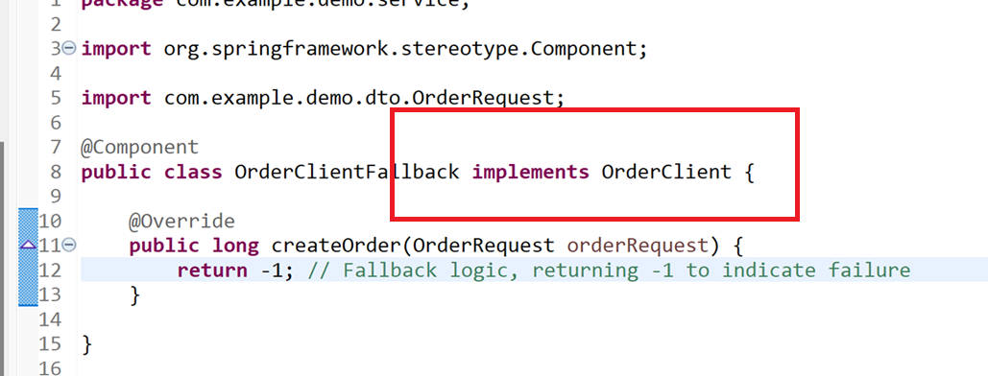

Slide 29
Storage
Device DB
User DB
Telemetry DB
Firmware DB

